Slide 1

Hepatitis C Detection Using Machine Learning
Livya Eldho
S3 MCA
MAC23MCA-2036

Slide 2
Contents
INTRODUCTION
2. LITERATURE REVIEW 1
3. LITERATURE REVIEW 2
4. LITERATURE REVIEW 3
5. SUMMARY
6. PROJECT PROPOSAL 7. CONCLUSION

Slide 3

01-.
Introduction

Slide 4
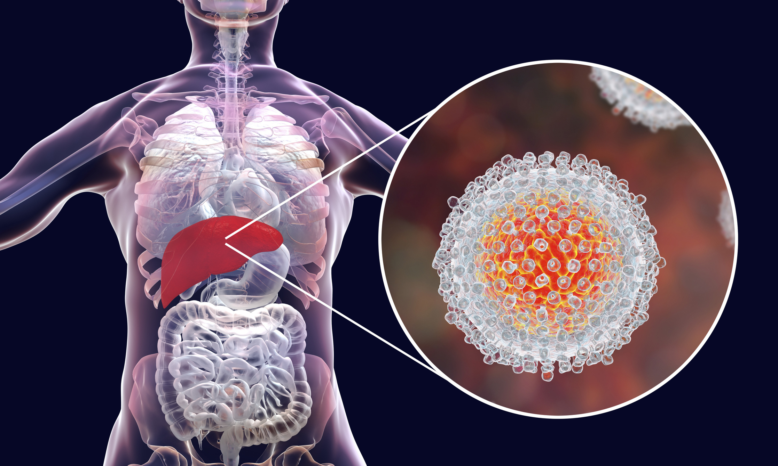
Introduction
Hepatitis C is a liver disease caused by the hepatitis C Virus
It can lead to severe liver damage, including fibrosis, cirrhosis and liver cancer.
Early detection of hepatitis c is crucial for effective treatment and prevention of serious complications.
Aims to develop a machine learning model to predict hepatitis c to facilitate early detection and to improve patient outcomes.
Develop and train machine learning models using relevant medical data

Slide 5
Literature Review 1
02-.

Slide 6
1. Effective factors in diagnosing the degree of hepatitis c using machine learning
Detection and classification of hepatitis c disease using selective features
This study showed that using data-mining algorithms also can be useful for HCV diagnosing.
The dataset was cleaned and preprocessed to ensure accuracy and consistency. Missing values were handled using appropriate techniques (imputation or exclusion).
In this study, three feature selection techniques were first used to select the most useful features for HVC analyzing.
For each selected feature set, three machine-learning algorithms were applied, and a diagnosing model for detecting Hepatitis C was reported.
Data-mining algorithms can be helpful to for HCV diagnosing.
Accuracy of all proposed algorithm is arrived to show the best model

Slide 7
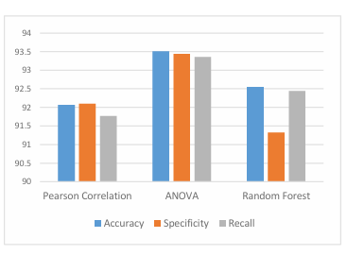
Dataset is collected from UCI repository
The dataset contains 1385 sample observations and each sample is represented by 29 features.
Pearson Correlation, ANOVA, and Random Forest as the main feature selection algorithms used
Comparing the evaluation metrics of the best models on these three feature selection methods showed that ANOVA was the best feature selection method
DNN and RF achieved the highest accuracy of 93.51 and 93.029

Slide 8
03-. Literature Review 2

Slide 9
2. Diagnosing the stage of Hepatitis C using machine learning
Performance evaluation of the proposed Intelligent Hepatitis C Stage Diagnoses System (IHSDS) empowered with machine learning in detection of stages of Hepatitis C using ANN.
Dataset was taken from UCI repository. The dataset contains 1385 sample observations and each sample is represented by 29 features. The value of attribute “histological staging” in this dataset indicates the Stage of the patient
This model is used to gain the maximum precision in the prediction by using the back-propagation algorithm of the Artificial Neural Network model. .
969 samples (70% of the dataset) are used for training the model, and the remaining 416 samples (30% of the dataset) are used for validation purposes
Different stages involved in the back-propagation algorithm include reading the training data, building and connecting the ANN layers, predicting error, updating parameters, and prediction precision.

Slide 10
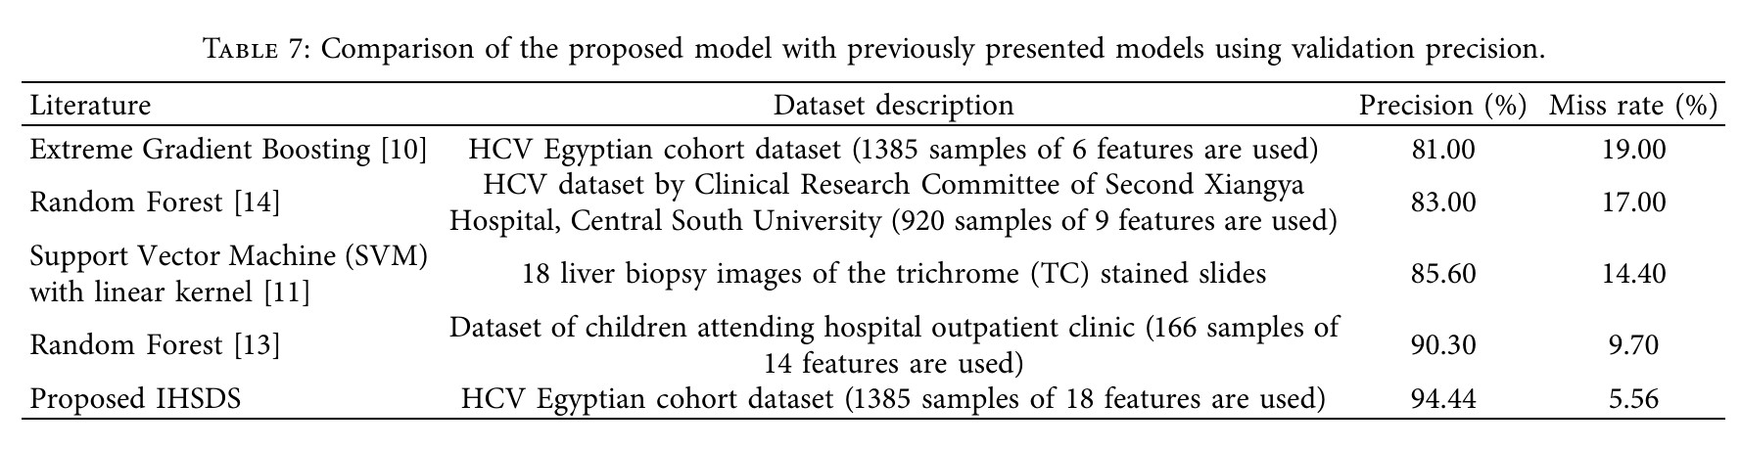
The proposed IHSDS was trained and validated using the dataset and shows 98.89% and 94.44% precision during training and validation phases, respectively.
The validation precision value of other methods is compared with the proposed model to state that the results provided by the proposed IHSDS empowered with machine learning are better than the results provided by other proposed methods (RF,SVM,LR) with regard to precision.

Slide 11
04-. Literature Review 3

Slide 12
3. Hepatitis C Virus (HCV) Prediction by Machine Learning Techniques
Performances of classifiers and tools on multi and binary class labels of the same HCV datasets of Egyptian patient’s from UCI repository .
The dataset used to build classification model consists of 1385 instances with 29 attributes
Seven ML techniques followed by different feature selection methods were used to evaluate the performance of the classifiers on dataset.
The multiclass label (i.e., Baseline histological staging) dataset instances consist of distinct values and frequencies, which are as follows F1, F2, F3 and F4.
The binary class label dataset consists of mild to moderate fibrosis as class label = 0 (F1 and F2) and advanced fibrosis as class label =1 (F3-F4).
The analytical tools such as Python-based Scikit learn and R based CARET package were used to perform data analysis

Slide 13
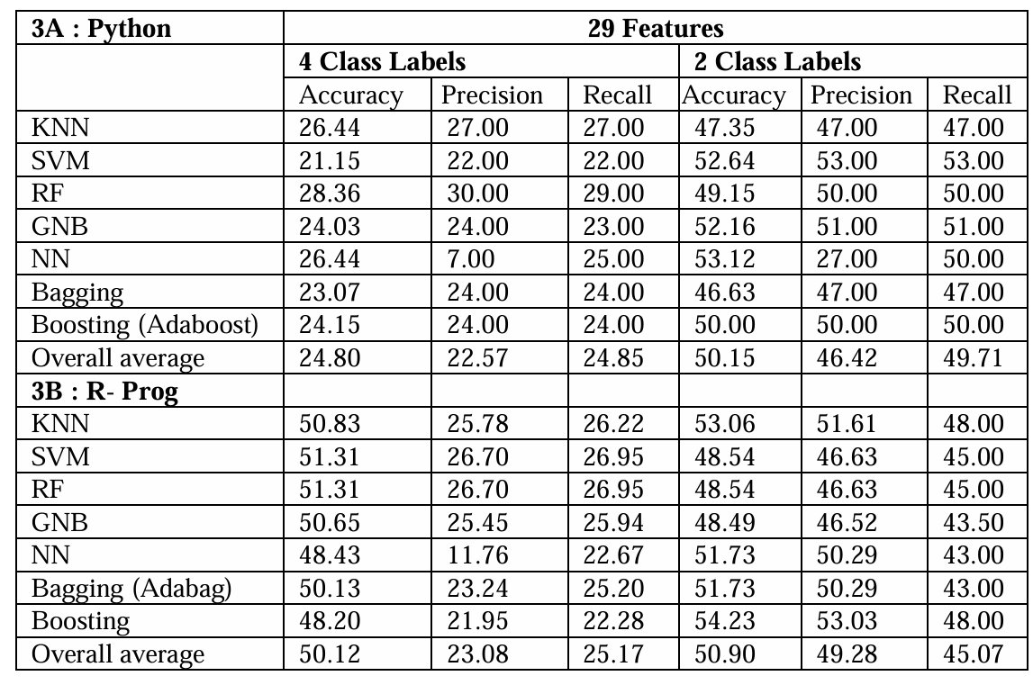
In Python, the multiclass dataset shows the highest accuracy (28.36%) in a random forest, followed by KNN with 26.44%.
Similarly, the binary dataset shows the highest accuracy (53.12%) in NN
In R , multiclass dataset shows the highest accuracies with similar performances in SVM and RF (51.31%).
In the binary class label, boosting shows the highest accuracy (54.23%)

Slide 14
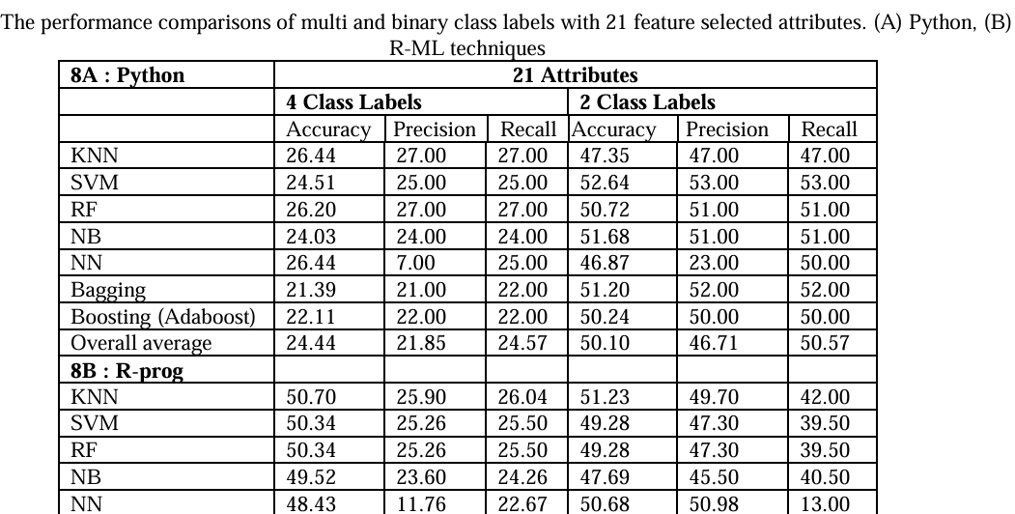

Slide 15
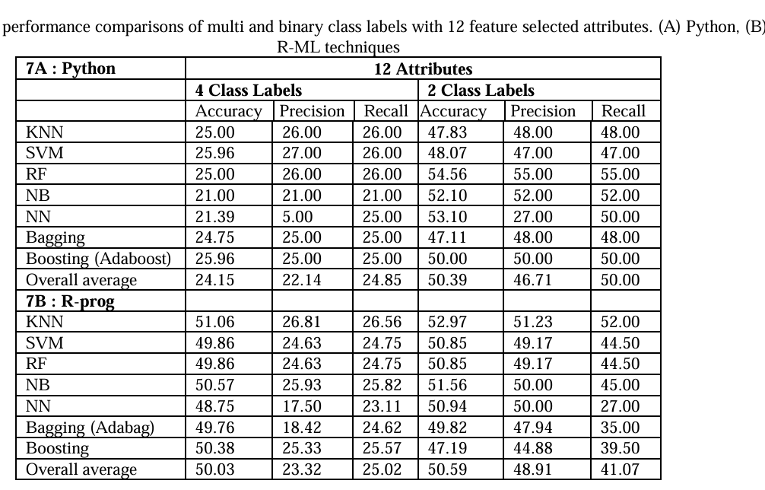
Within the comparison of 3 datasets features, the 12 selected features overall average accuracy, precision, and recall shows similar performances to 29 and 21 selected features in both class labels and tools. Thus, indicating 12 selected features can be useful for the prediction of the HCV dataset.
Despite class labels and tools used, average performances of evaluation metrics of the classifiers are in the order of SVM, RF, KNN, NN, and NB.

Slide 16

05-.
Summary

Slide 17
Comparison
Title | Algorithm | Accuracy | Dataset
“Effective factors in diagnosing the degree of hepatitis c using machine learning” Mohammadjavad Sayadi, Elahe Gozali, Malihe Sadeghi 2023; 12: 137 | DNN,RF | 93.51 , 93.029 | Dataset of Egyptian patients from UCI repository containing 1385 instance,29 features
“Diagnosing the Stage of Hepatitis C Using Machine Learning” |Journal of Healthcare Engineering, Muhammad Bilal Butt, Majed Alfayad, Shazia Saqib, M. A. Khan, Muhammad Adnan Khan ,and Nouh Sabri Elmitwally, Munir Ahmad | Volume 2021, Article ID 8062410 | ANN | 94.44 | Dataset of Egyptian patients from UCI repository containing 1385 instance,29 features
Satish CR Nandipati, Chew XinYing, Khaw Khai Wah. ”Hepatitis C Virus (HCV) Prediction by Machine Learning Techniques”. Applications of Modelling and Simulation VOL 4, 2020, 89-100 | SVM | 52.64 (binary class label) | Dataset of Egyptian patients from UCI repository containing 1385 instance,29 features

Slide 18

06-. Project Proposal

Slide 19
Comparative study of three algorithms
RF
ANN
SVM
Classify hepatitis c under four categories
no fibrosis
mild fibrosis
moderate fibrosis
severe fibrosis/cirrhosis
Develop a machine learning model for the detection of Hepatitis C
Comparative study of three algorithms Random Forest, ANN, Support Vector Machine.
Patients can diagnose their condition without the assistance of a medical expert

Slide 20

07-.
Conclusion

Slide 21
Dataset
Dataset is taken from UCI machine learning repository 1385 records of patients with different grades of HCV including 1 class variable and 28 features, which can be categorized into different categories before the start of treatment such as:
Demographic
Symptom
Liver Function Tests (LFTs)
Blood Panels
The class variable (Baseline histological staging) include numbers from 1 to 4 which indicates different stages in hepatitis c disease which are :
1. no fibrosis
2. mild fibrosis
3. moderate fibrosis
4. severe fibrosis/cirrhosis

Slide 22
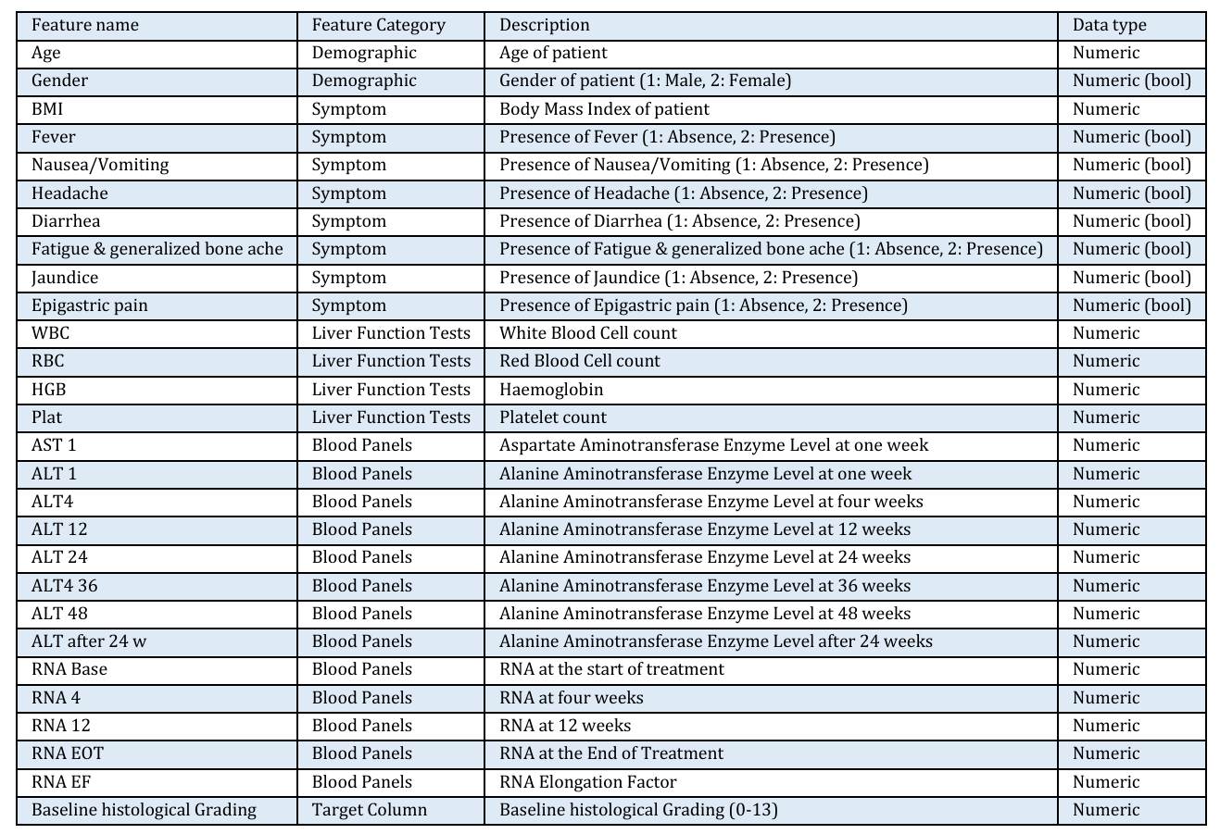

Slide 23
ALT, or alanine aminotransferase, is an enzyme found primarily in the liver.
AST, or aspartate aminotransferase, is another enzyme found in various tissues, including the liver, heart, muscles, and kidneys
GGT, or gamma-glutamyl transferase, is an enzyme found in the liver and other tissues, including the bile ducts
Bilirubin is a yellow pigment that is a byproduct of the breakdown of hemoglobin
Albumin is a protein produced by the liver that plays several crucial roles in the body
RNA (ribonucleic acid) is a crucial molecule involved in various biological processes
RNA EOT refers to monitoring viral RNA levels at the end of treatment to assess the success of the therapy
Baseline histological grading to evaluate the degree of liver inflammation and fibrosis

Slide 24
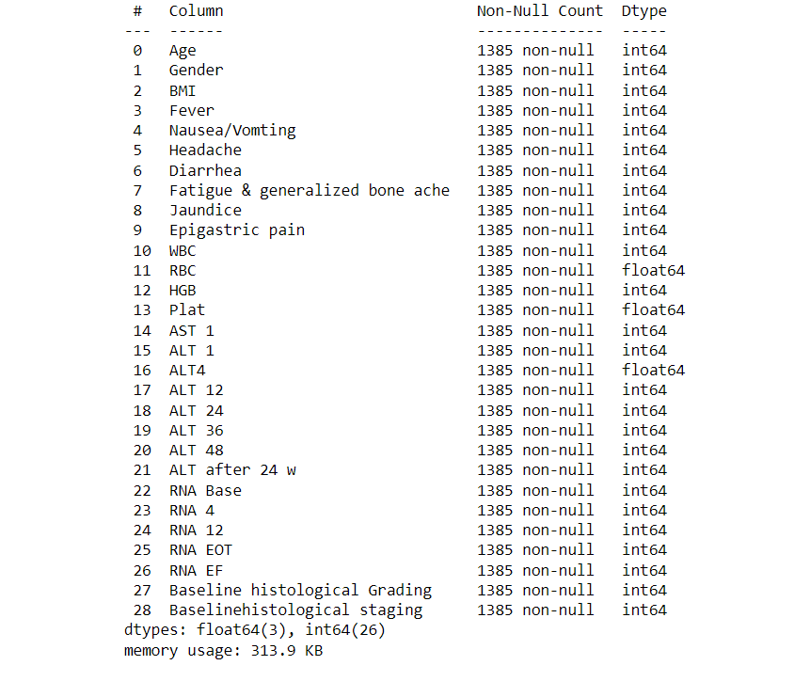
EXPLORATORY ANALYSIS Dataset has 1385 rows and 29 features

Slide 25
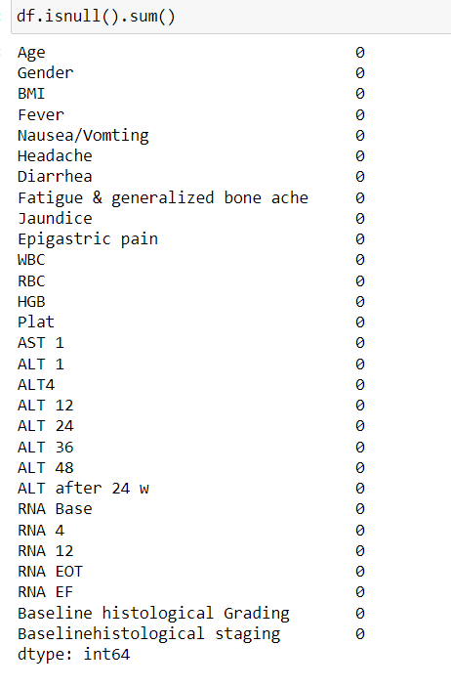
There are no missing values in the dataset

Slide 26
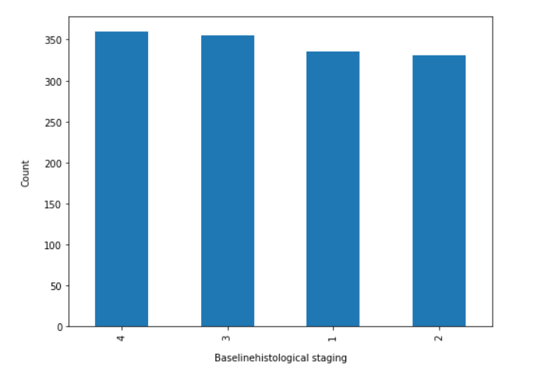
Handling class imbalance Baseline histological staging class is balanced. There is no large variation between number of people in the different stages

Slide 27
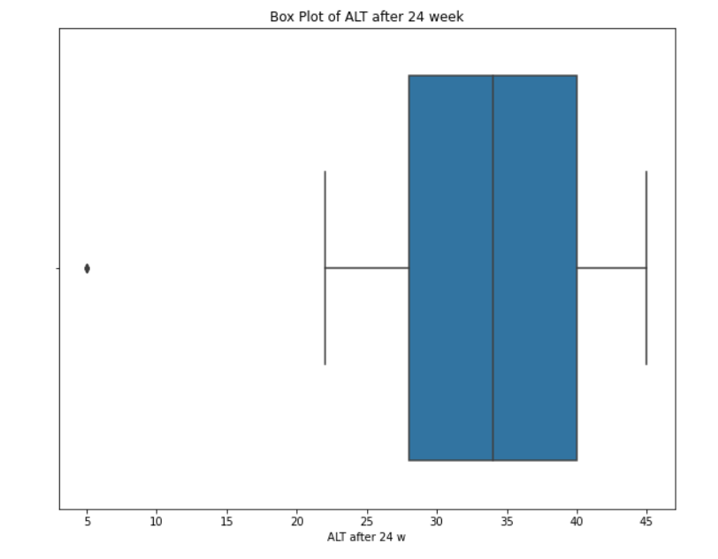
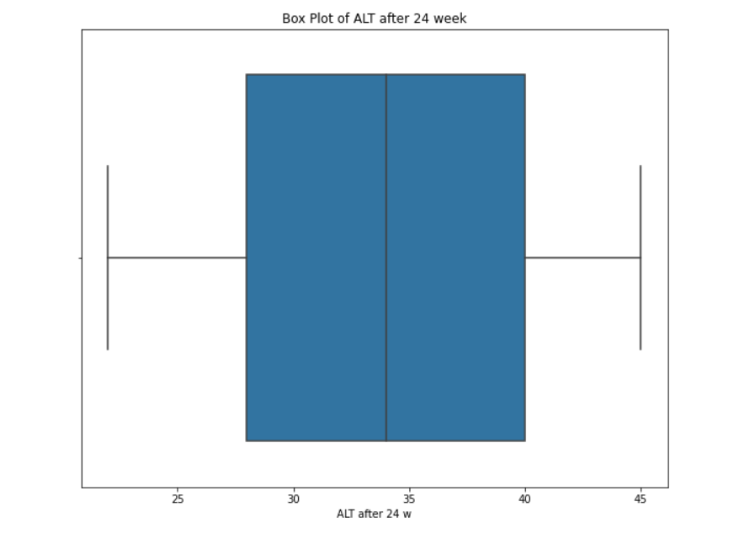
Handling outliers ALT after 24 week shows one outlier. So value equals to 5 is removed.

Slide 28
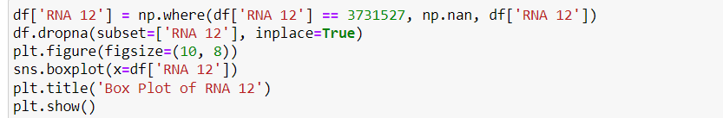
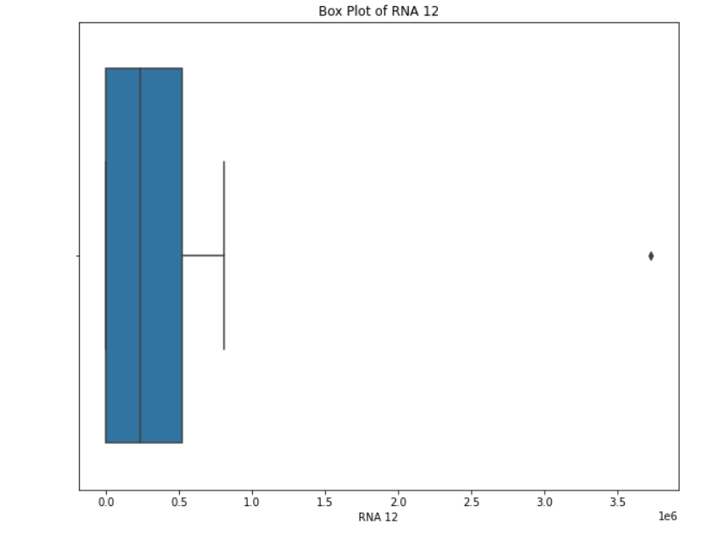
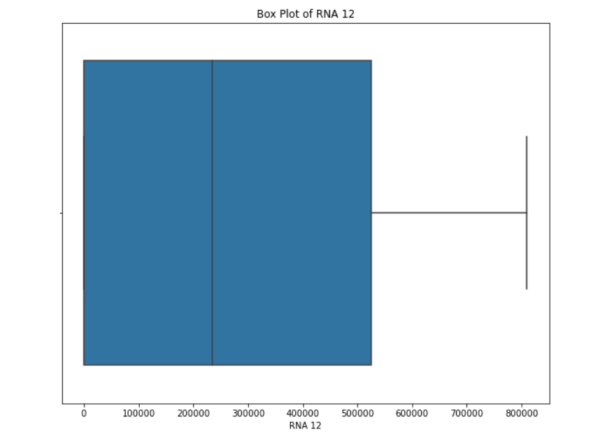

Slide 29
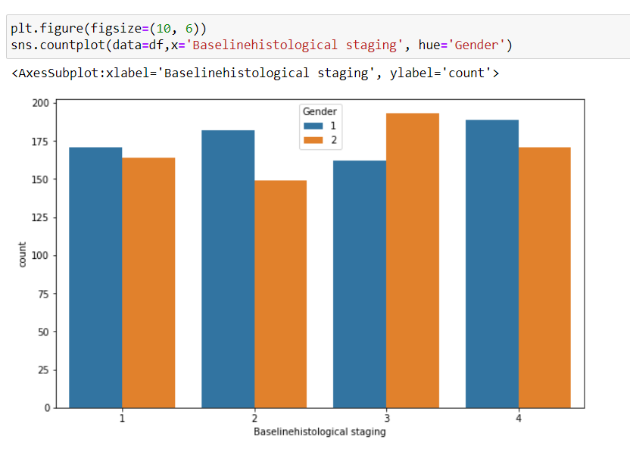
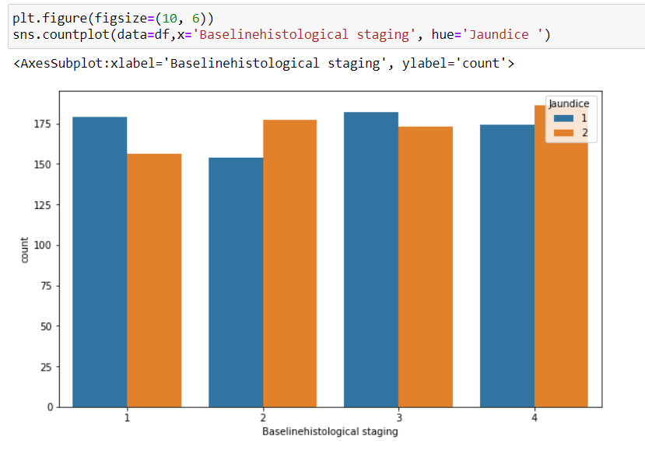
The plot indicates that for most of the stages (1,2 and 4),Male has a higher count compared to female. For stage 3, female is more represented. The higher count of female in stage 3 suggests that individuals in this gender may be more likely to reach or be diagnosed at this stage.
Patients in stage 4 (Cirrhosis stage) are more likely to be affected by jaundice

Slide 30
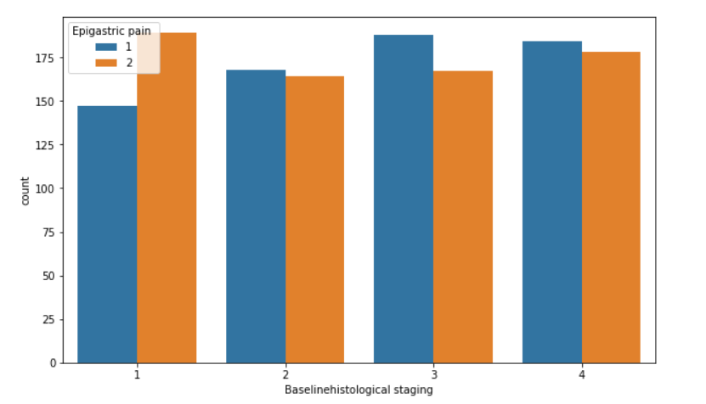
Patient in stage 1 in hepatitis C are more likely to report experiencing epigastric pain

Slide 31
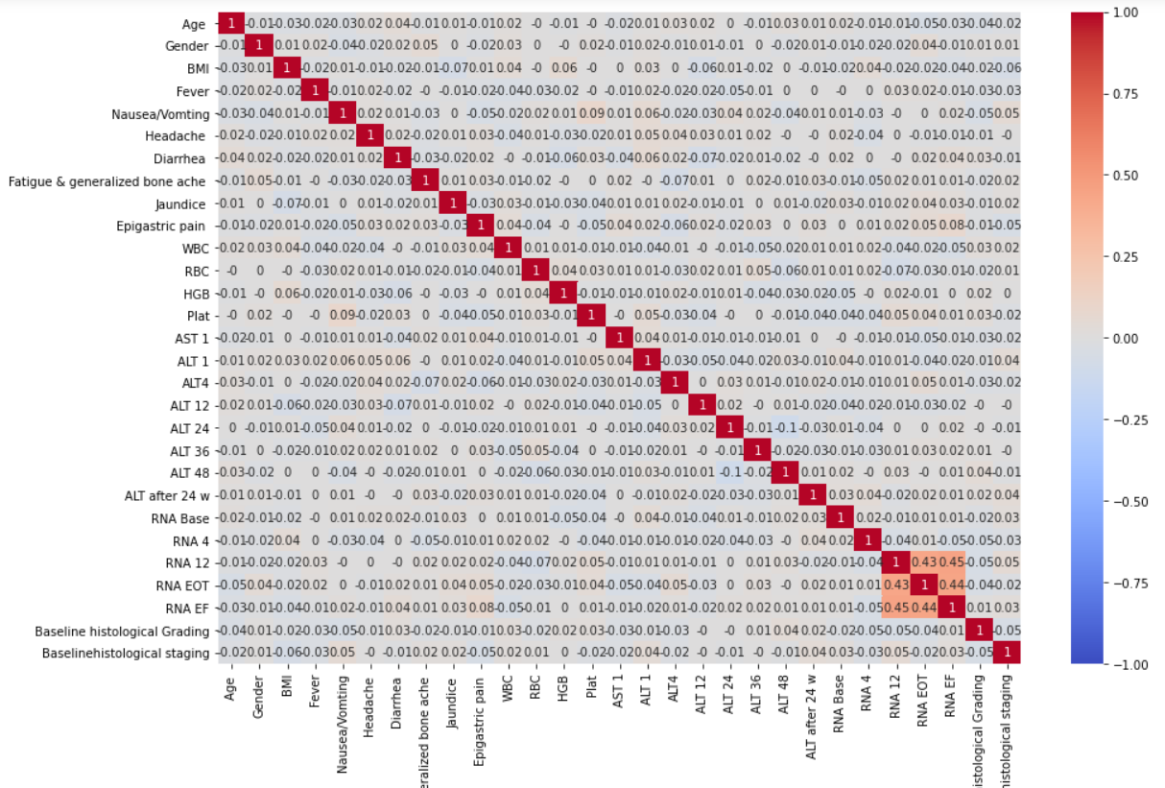
Fatigue & bone ache

Slide 32
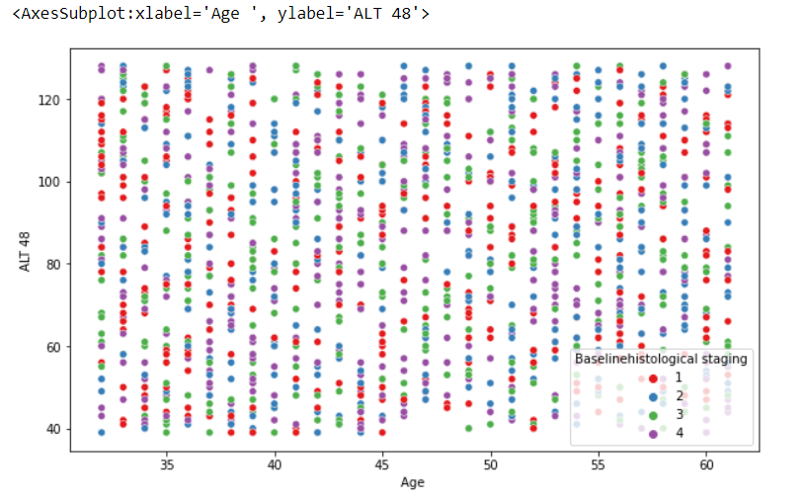
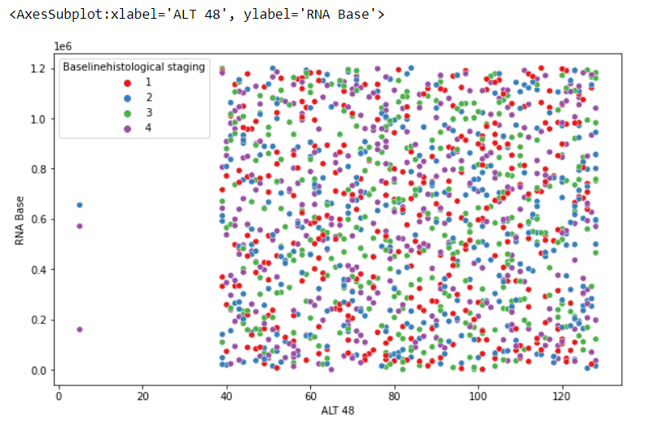
Patients below age 35 show a slight increase in the number of stage 1 cases.
The absence of data between 0 to 40 in ALT 48 might imply that disease state only manifest at ALT 48 levels above 40. It suggests that ALT 48 values below 40 may not associated with specific histological stages under study

Slide 33
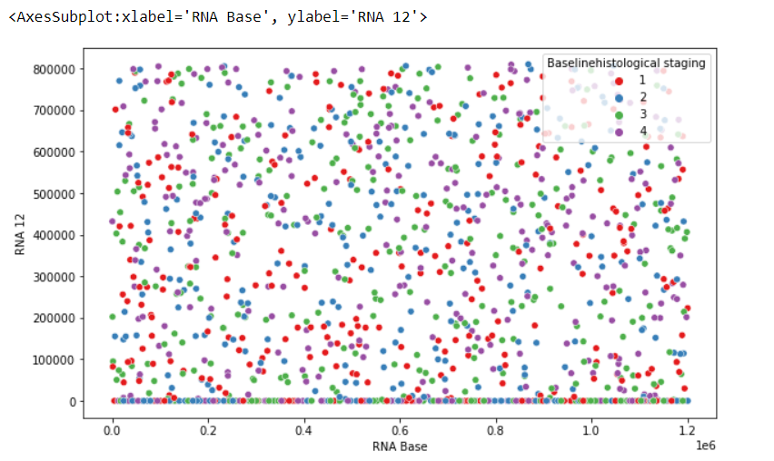
Elevated level of RNA Base are more likely to be considered to be stage 3

Slide 34
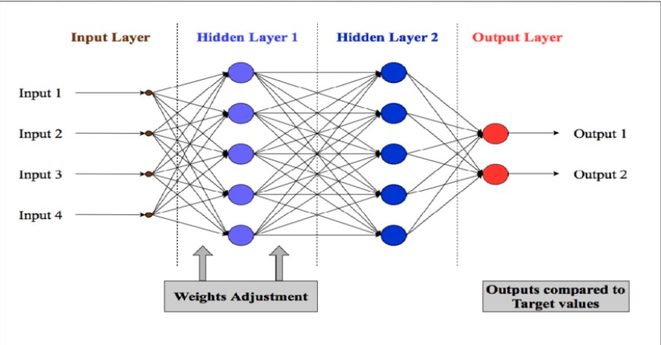
Artificial Neural Networks (ANN) ANN are computational models inspired by the human brain's neural networks. They consist of interconnected nodes (neurons) arranged in layers. Each neuron processes input data through weighted connections and activation functions to produce output. Algorithm: Initialization: o Initialize the weights and biases for all layers of the network randomly. Forward Propagation: o For each input sample, calculate the output of each neuron by computing the weighted sum of inputs and applying the activation function. o Pass the output from the input layer through the hidden layers and finally to the output layer. Loss Calculation: o Compute the loss by comparing the predicted output with the actual target using a loss function (e.g., Mean Squared Error for regression or Cross-Entropy for classification).

Slide 35
Backpropagation: o Calculate the gradient of the loss function with respect to each weight and bias using the chain rule. o Update the weights and biases by moving them in the direction that reduces the loss, typically using an optimization algorithm like Gradient Descent. Iteration: o Repeat the forward propagation, loss calculation, and backpropagation steps for multiple epochs until the model converges (i.e., the loss stops decreasing significantly). Prediction: o After training, use the trained network to make predictions on new data. Pseudocode: Initialize weights and biases For each epoch: For each input sample: Perform forward propagation through all layers Calculate the loss Perform backpropagation to update weights and biases End For End For Use the trained model to make predictions

Slide 36
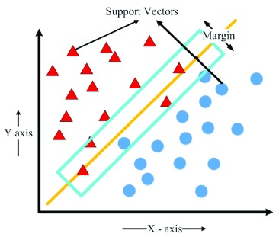
Support Vector Machines (SVM) Supervised learning models used for classification and regression tasks. SVMs are effective in high-dimensional spaces and are especially useful for binary classification. Data Preparation: o Represent the input data as feature vectors. Hyperplane Selection: o Find the hyperplane that maximizes the margin between the two classes. The margin is the distance between the hyperplane and the nearest data point from either class. Optimization: o Use optimization techniques (like Quadratic Programming) to minimize the classification error and maximize the margin.

Slide 37
Support Vectors: o Identify the support vectors, which are the data points closest to the hyperplane. Kernel Trick (Optional): o If the data is not linearly separable, apply a kernel function (e.g., RBF, Polynomial) to transform the data into a higher-dimensional space where a linear separation is possible. Prediction: o Use the optimal hyperplane (or decision boundary) to classify new data points. Pseudocode: Transform the input data using a kernel function (if needed) Find the optimal hyperplane that maximizes the margin Identify support vectors For each new input sample: Calculate the decision function based on the hyperplane Assign the sample to a class based on the sign of the decision function

Slide 38
Random Forest (RF) Ensemble learning method that builds multiple decision trees and merges their outputs to make a more accurate and stable prediction. Each tree is built using a random subset of features and data samples, making the model less prone to overfitting and more robust. Random Forest is widely used for both classification and regression tasks. • Bootstrap Sampling: o Randomly select samples from the training data (with replacement) to create multiple datasets (bootstrap samples). • Tree Construction: o For each bootstrap sample, construct a decision tree by recursively splitting the data based on the best feature that maximizes the separation of classes (or minimizes the error in regression). o During the construction, at each split, randomly select a subset of features to choose the best split from. • Aggregation: After all trees are built, aggregate their predictions: o For classification, use majority voting (i.e., the class that gets the most votes is the final prediction). o For regression, average the predictions from all trees. • Prediction: o Use the aggregated output from all trees to make the final prediction for new data.

Slide 39
Pseudocode: For each tree in the Random Forest: Bootstrap sample the data Randomly select a subset of features for each split Build the decision tree using the selected features and bootstrap sample Repeat until the maximum depth or minimum sample size is reached End For For each new input sample Pass the sample through each decision tree in the forest Record the output (class or regression value) from each tree Aggregate the outputs: - For classification: Use majority voting to determine the final class label - For regression: Compute the average of the outputs to get the final prediction Return the aggregated result as the final prediction

Slide 40
PACKAGES AND FUNCTIONS 1.Pandas 2.Seaborn 3. Matplotlib 4.Numpy 5. sklearn RandomForestClassifier() • read_csv()`: Reads a CSV file into a DataFrame. • DataFrame.shape`: Returns the dimensions of the DataFrame. • DataFrame.info()`: Provides a concise summary of the DataFrame. • DataFrame.replace()`: Replaces values in a DataFrame. • value_counts()`: Returns the counts of unique values.

Slide 41
• isnull()`: Checks for missing values in the DataFrame. • DataFrame.dtypes()`: Selects columns based on data types. • DataFrame.columns`: Accesses the column labels of the DataFrame. • heatmap()`: Plots a heatmap. • boxplot()`: Identify outliers • figure()`: Creates a new figure. • show()`: Displays the figure. • title()`: Sets the title of the plot. • subplots()`: Creates a figure and a set of subplots. • train_test_split(): Splits data into training and testing sets. • MLPClassifier(): Creates a Multi-Layer Perceptron (neural network) classifier. • SVC(): Creates a Support Vector Classifier. • accuracy_score(): Calculates the accuracy score of model predictions.

Slide 42
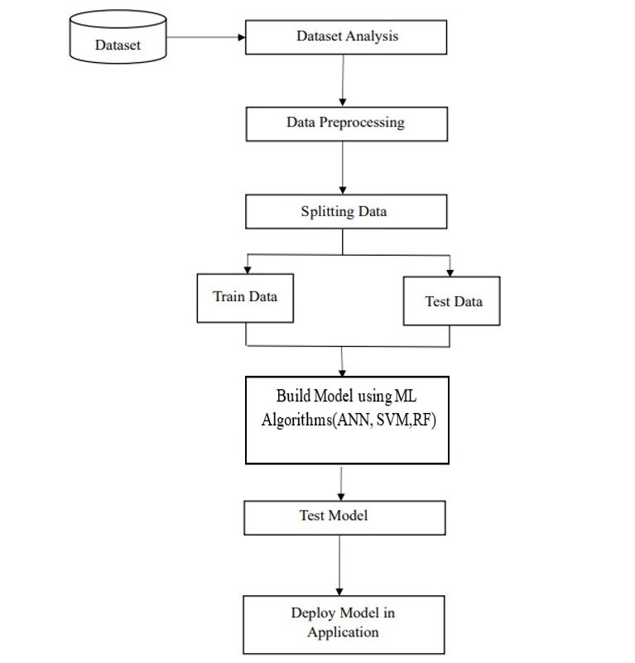
Project Pipeline

Slide 43
TIMELINE Submission of project synopsis with Journal Papers - 22.07.2024 Project proposal approval - 26.07.2024 Presenting project proposal before the Approval Committee -29.07.2024 & 30.07.2024 Initial report submission - 12.08.2024 Analysis and design report submission - 16.08.2024 First project presentation - 21.08.2024 & 23.08.2024 Sprint Release I - 30.08.2024 Sprint Release II - 26.09.2024 Internal project presentation - 30.09.2024 & 01.10.2024 Sprint Release III - 18.10.2024 Submission of the project report to the guide - 28.10.2024 Final project presentation - 28.10.2024 & 29.10.2024 Submission of project report after corrections - 01.11.2024

Slide 44
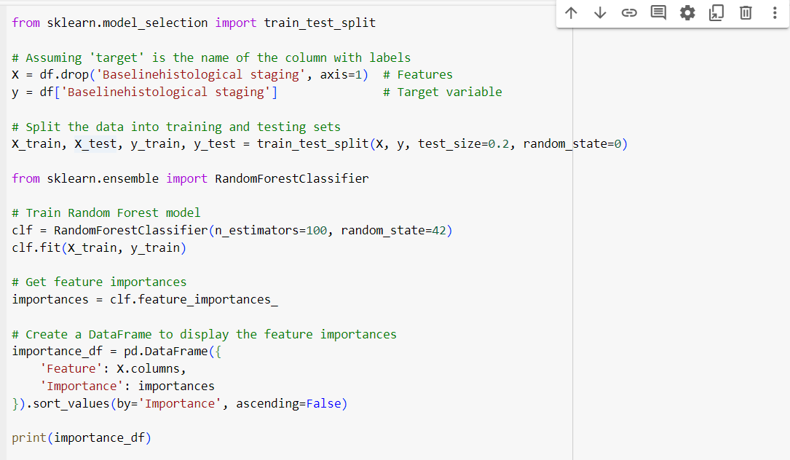
Feature Selection

Slide 45
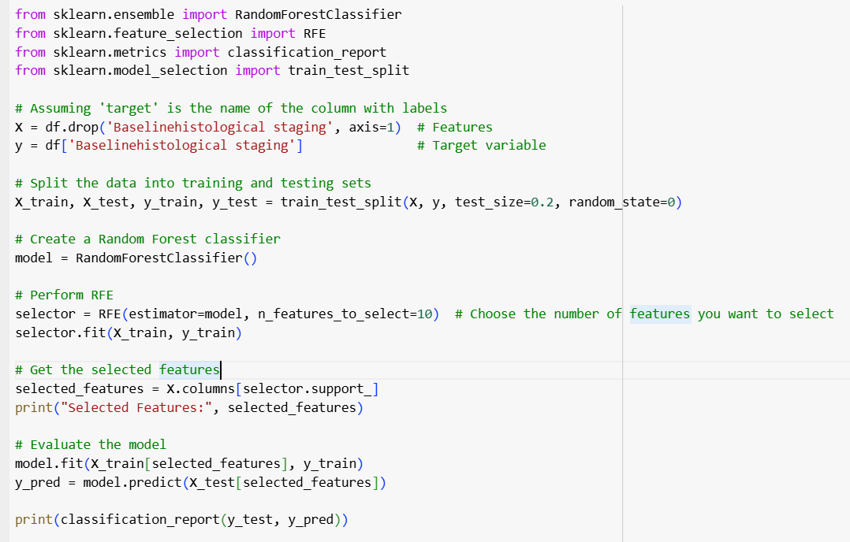
Feature Selection
Feature selection is a strategy for limiting the input variable to the model by removing insignificant data and only using valuable data. The purpose of feature selection in machine learning is to determine the best set of characteristics for building effective models. In this study, for selecting the most important feature, we used the Recursive Feature Elimination (RFE) method.

Slide 46
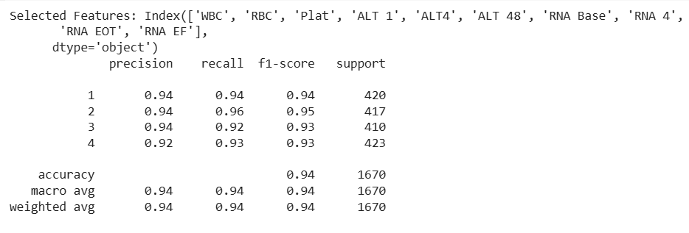

Slide 47
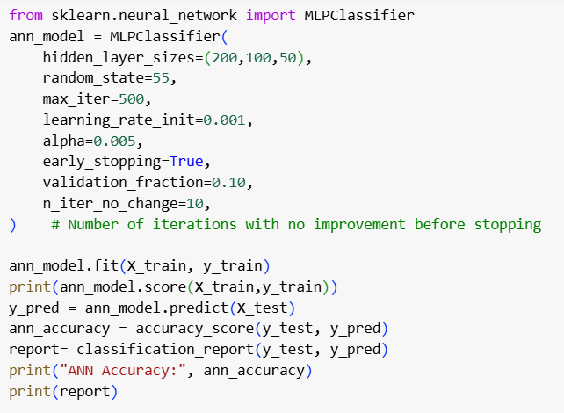
1. Training and testing of ANN model Testing accuracy: 0.8814 Training accuracy: 0.9508

Slide 48
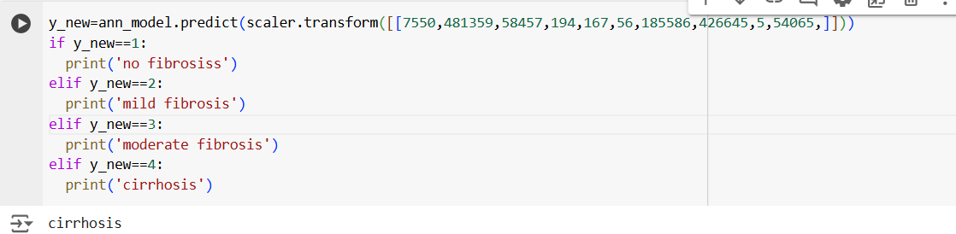
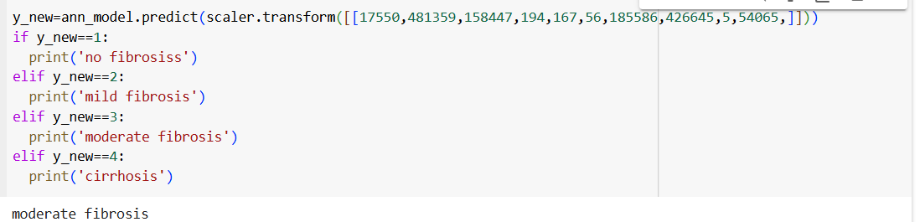

Slide 49
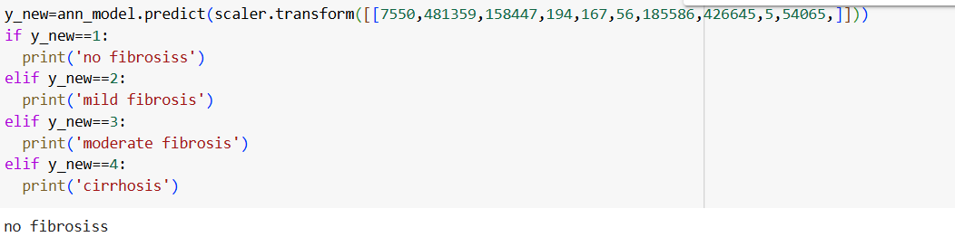

Slide 50
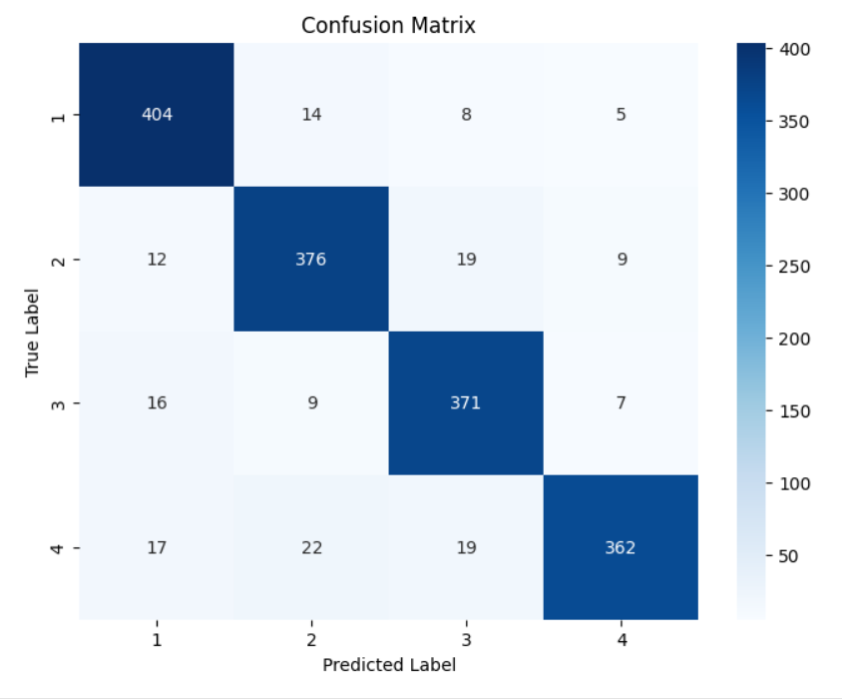

Slide 51
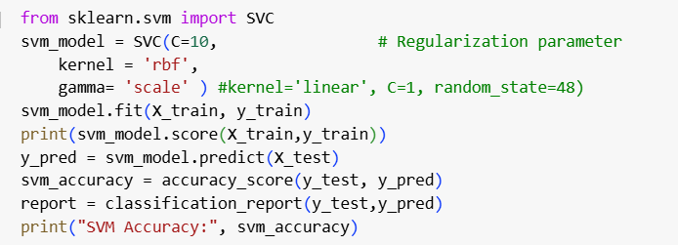
2 . Training and testing of SVM model
Testing Accuracy :0.90
Training accuracy : 0.95

Slide 52
C is a regularization parameter that controls the trade-off between maximizing the margin and minimizing the classification error.
Typical values for C can range from 0.01 to 1000
The kernel is a function that transforms the input data into a higher-dimensional space where it may be easier to classify.
Kernel: rbf(for non-linear problems).
It is particularly useful when the relationship between class labels and attributes is non-linear.
Gamma : Defines the reach of influence of a training sample.

Slide 53
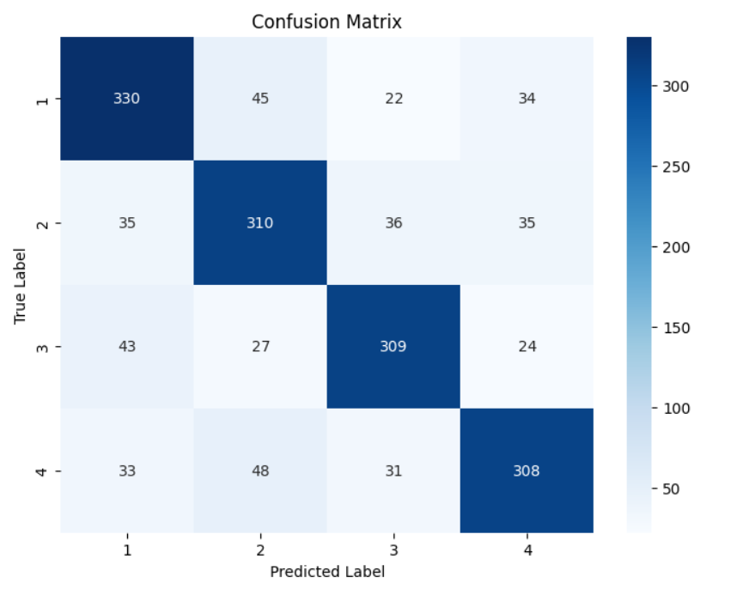

Slide 54
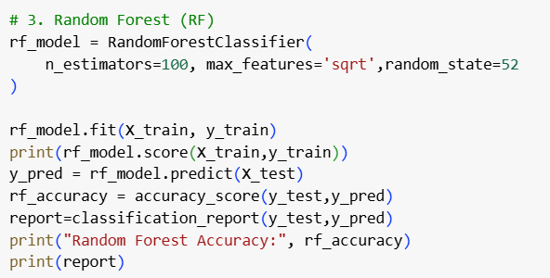
3. Training and testing of RF model
Testing accuracy : 0.90
Training accuracy :0.98

Slide 55
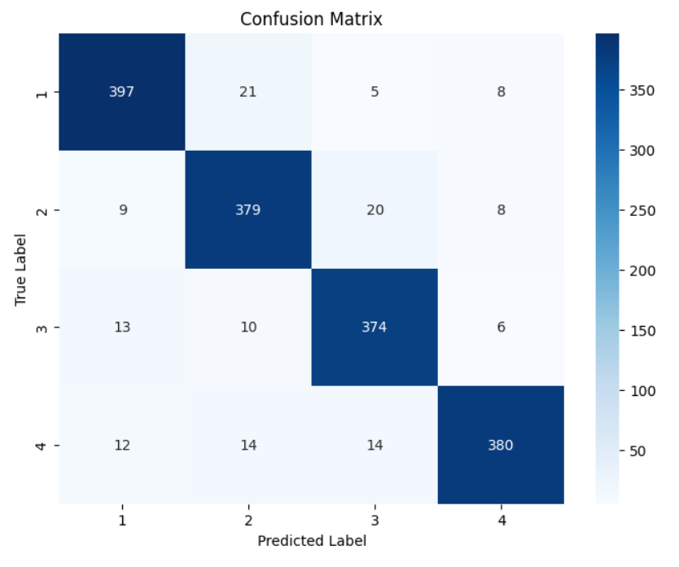

Slide 56
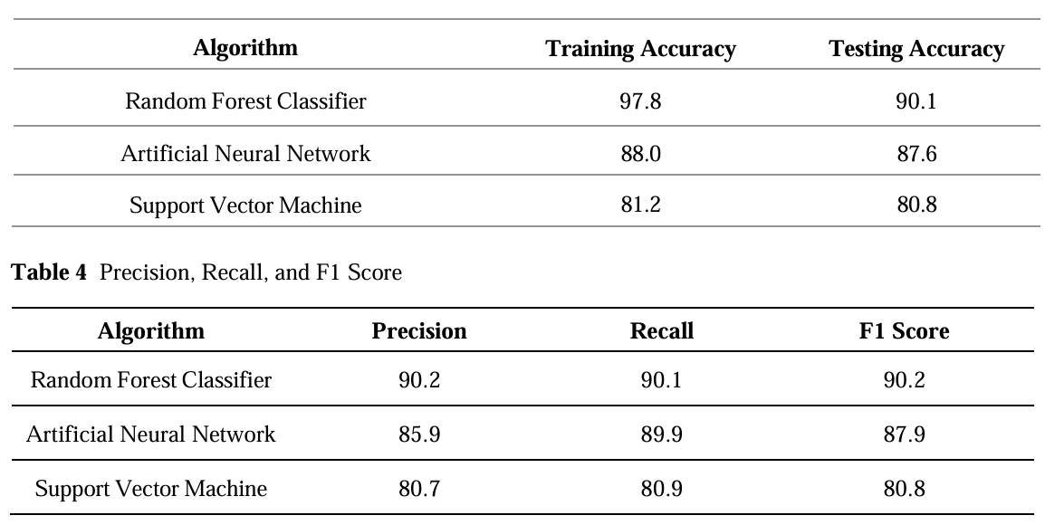
Random Forest has the highest Performance
95
95.08
88.14
95
90

Slide 57

Home Page

Slide 58
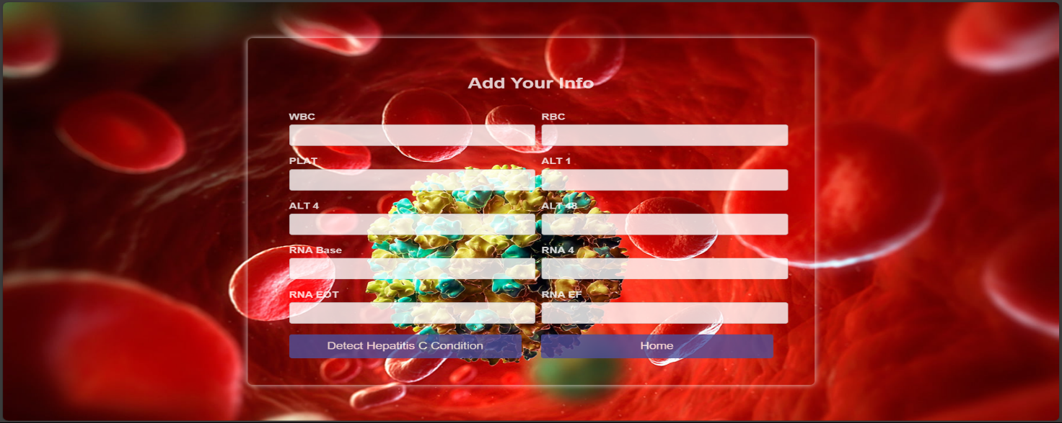
Input form Page

Slide 59
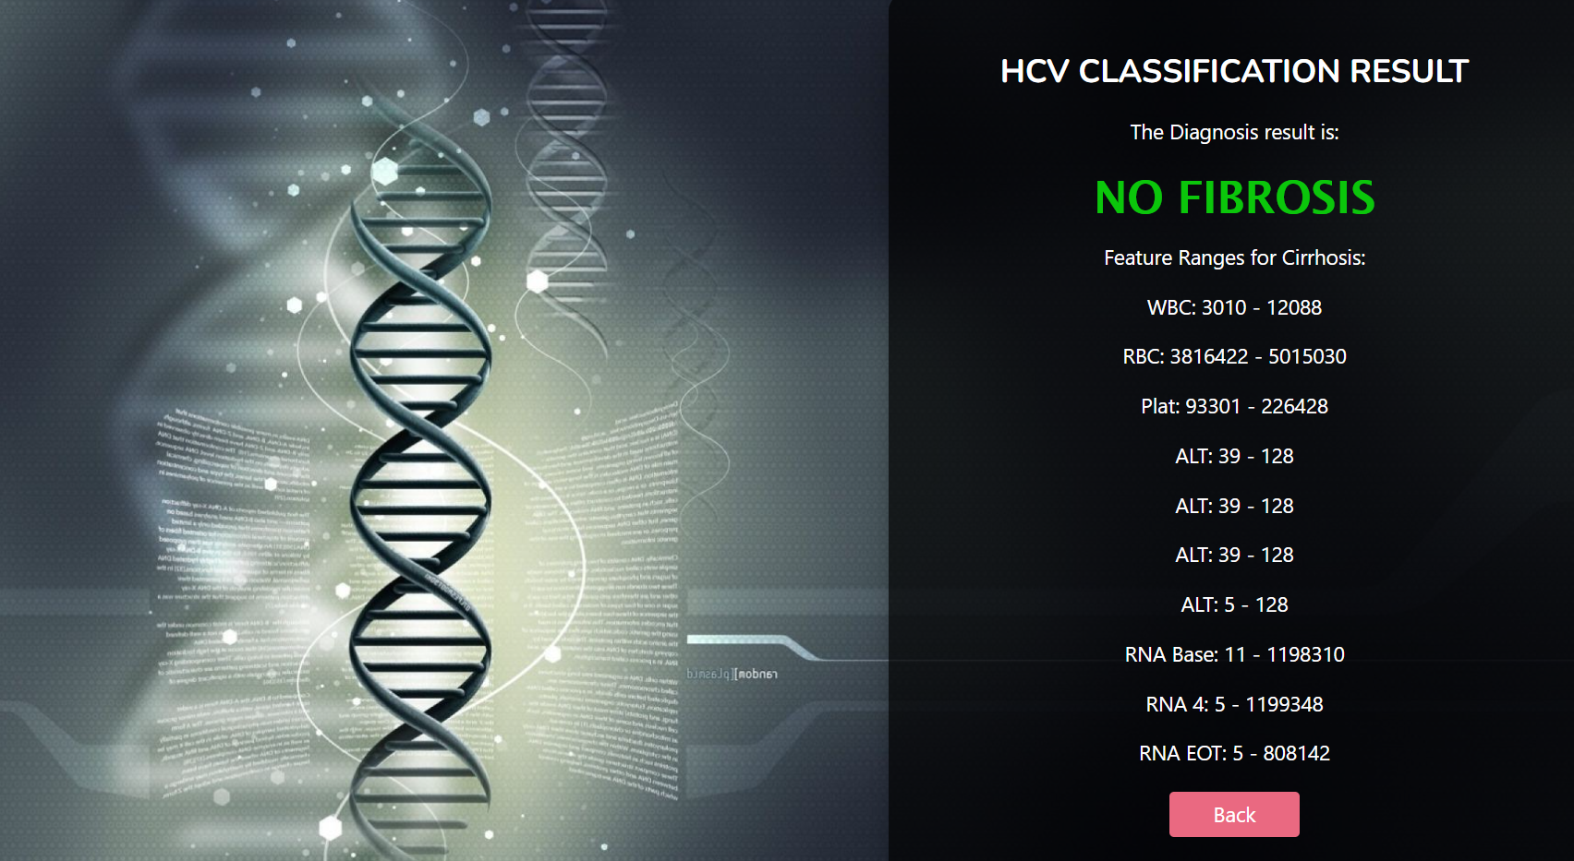
Output

Slide 60
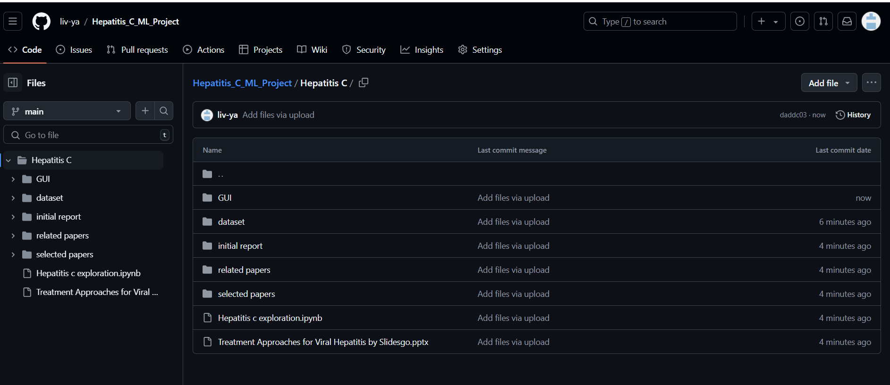
GIT HISTORY

Slide 61
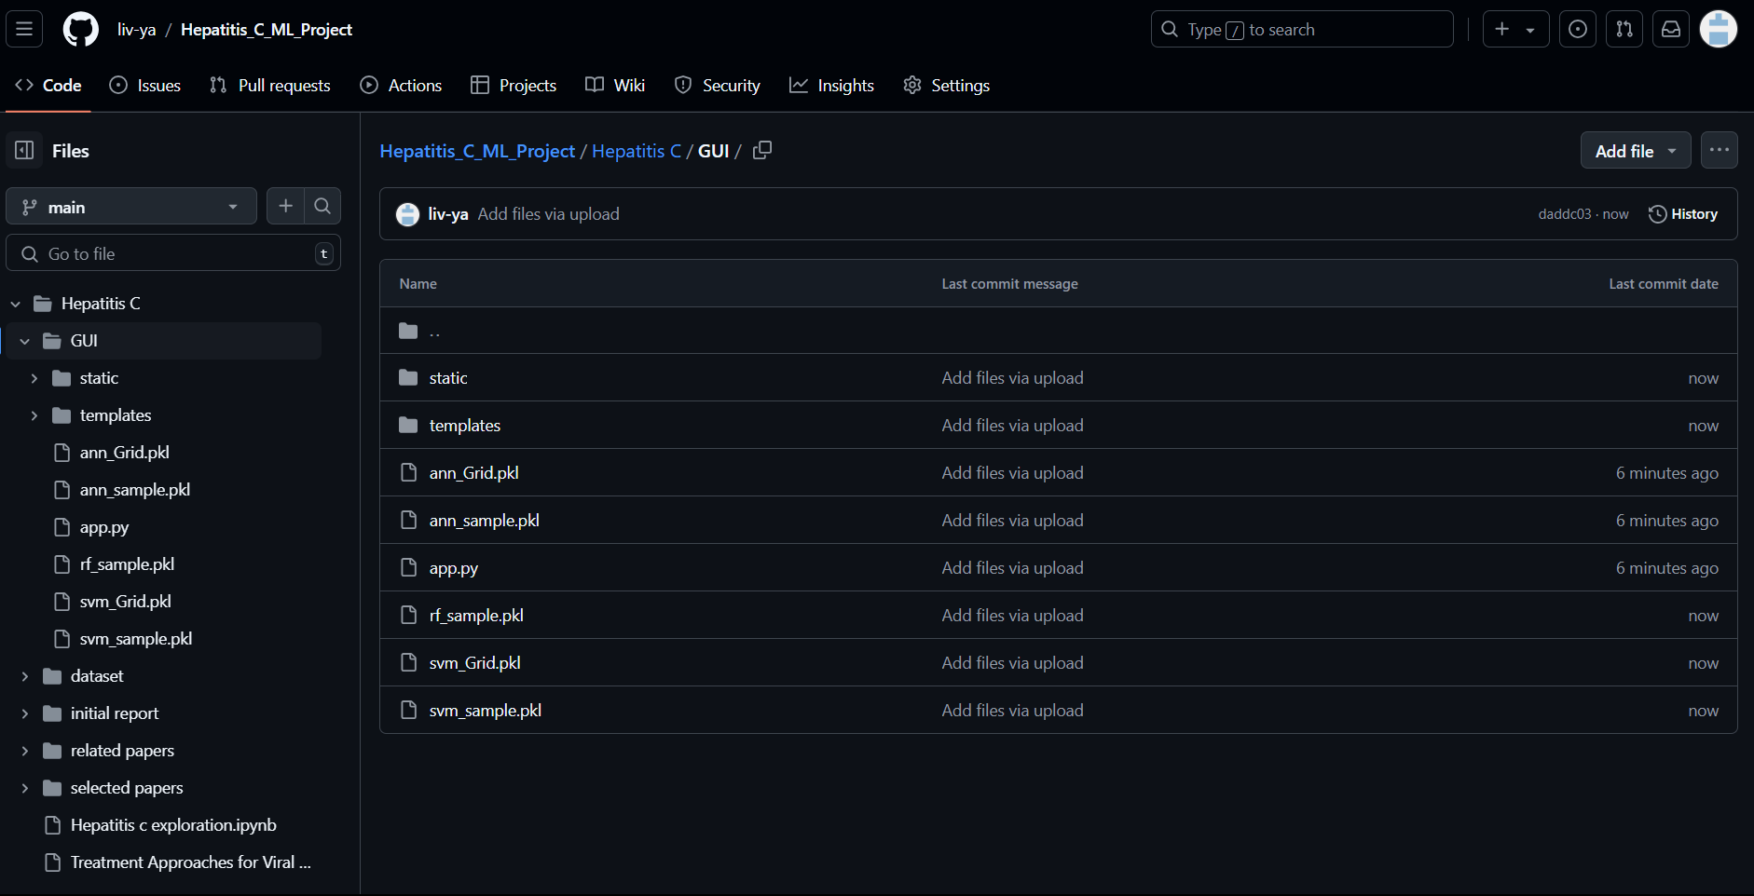
GIT HISTORY OF WEB INTERFACE

Slide 62
Thank You

